Slide 1
Let’s Build a Game Braelyn Sullivan

Slide 2
Agenda
What is Phaser?
What We’ll Build
Getting Started with GitHub
Images, Sprites and Animations
Input and Physics
Controls and Cameras
Finishing Our Game!

Slide 3
What is Phaser?

Slide 4
Phaser is…
https://phaser.io/
Notes:
Phaser is…
- an all-in-one JS framework for Canvas & WebGL powered browser games
- easily ports to mobile devices with Cordova, etc.
- includes methods for handling sprites and animation, physics, input, sound, cameras, etc.

Slide 5
What We’ll Build

Slide 6
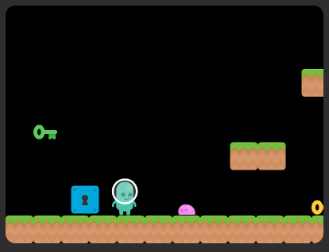
What We’ll Build
Simple keyboard-driven arcade game
Alien to collect keys and unlock the locks
Avoid slime enemies
Notes:
We’re going to build a simple arcade-style game with our little alien dude.
He’s going to collect the keys we’ve hidden throughout the level and use them to unlock the corresponding locks.
He also needs to avoid the slime and any other enemies we throw in there.
PLAY THE EXAMPLE
Now let’s get started!

Slide 7
Getting Started with GitHub

Slide 8
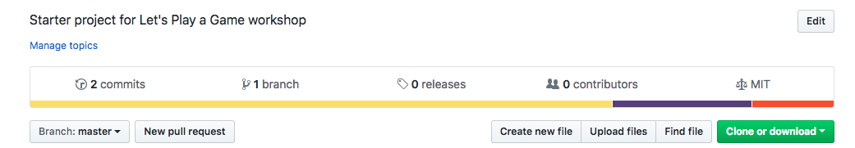
Getting Started with GitHub
https://github.com/brsullivan/pearlhacks2019-phaser-starter
Notes:
Go to this link or search GitHub for just the highlighted part
Clone the repository by following instructions below ** make sure to swap whatever you want to call your project for the <your-project-name>
** Download NPM & Node.js if you don’t already have them
Open terminal shell and run NPM INSTALL in the project directory
Once install finishes, run NPM RUN START to launch the app!
PAUSE HERE TO MAKE SURE EVERYONE CAN RUN THE INITIAL VERSION

Slide 9
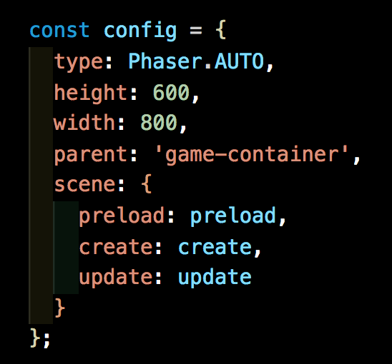
Game Setup
Notes:
type: Phaser.CANVAS, Phaser.WEBGL or Phaser.AUTO – specifies the type of display to render, AUTO is usually a safe bet as default height + width: defines rendering size of our game
parent: defines what ID to look for when Phaser is ready to place our game element
Scene: object contains details of a game scene
Preload – runs once at the very start of execution
Create – runs when the scene is launched
Update – runs continuously throughout game and play execution

Slide 10
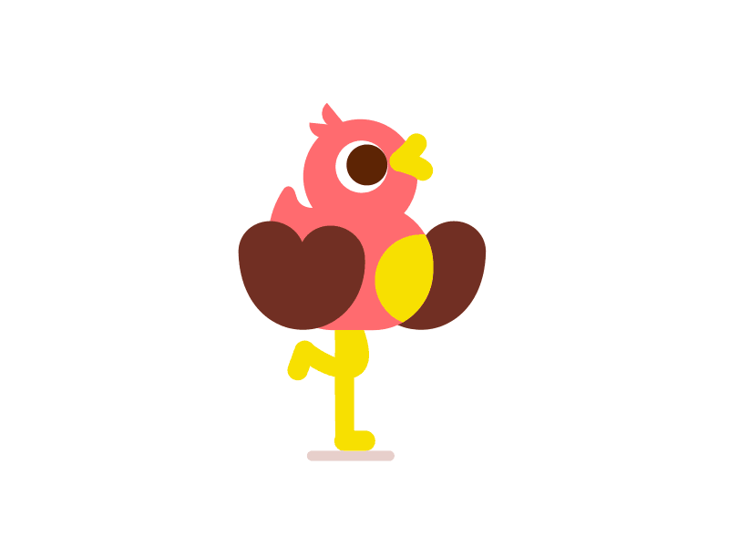
Images, Sprites and Animations
https://giphy.com/tonybabel

Slide 11
Images and Sprites
An image is a light-weight object used for displaying static images
A sprite is used for displaying both static and animated images
Can have input events and physical bodies
Can be animated, while images cannot
Notes:
Images are a light-weight object for displaying static images (think logos, background image, decoration)
Images can’t be animated and generally can’t be interacted with (see cloud)
Sprites are a heavier object for static and animated images
Sprites are created from a sprite sheet with multiple images and display one frame at a time (see alien)
Sprites can receive input and be affected by physics engines

Slide 12
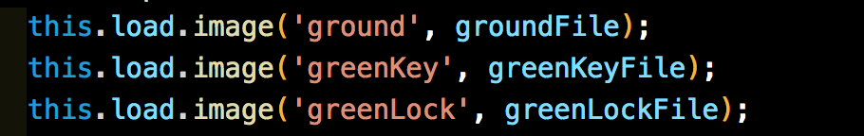
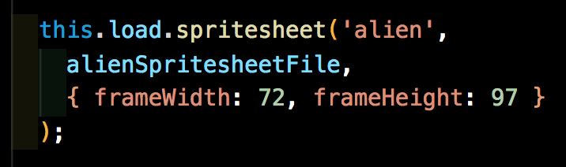
Adding Images + Sprites
Notes:
THIS CODE IS ALREADY IN THE STARTER PROJECT – so follow along with me here while I tell you what it does.
To make images accessible to the JS code, you have to import the file as a variable.
Then, you need to load the image into the game engine. We’ll do this in our preload() function
Images are a simple 1:1 association – a key name and a file reference
Spritesheets are a little different – in addition to key name and file reference, you also have to include the frameWidth and frameHeight.
(PULL UP SPRITESHEET and EXPLAIN)

Slide 13
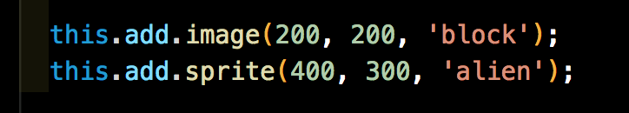
Adding Images + Sprites
Notes:
THIS IS ALSO ALREADY IN THE STARTER CODE
The way you add them is very similar. This is done in our create() function
This code creates what we see on our screen right now.
SWITCH TO CODE and add this.player before this.add.sprite
Now, we’re going to create some animations

Slide 14
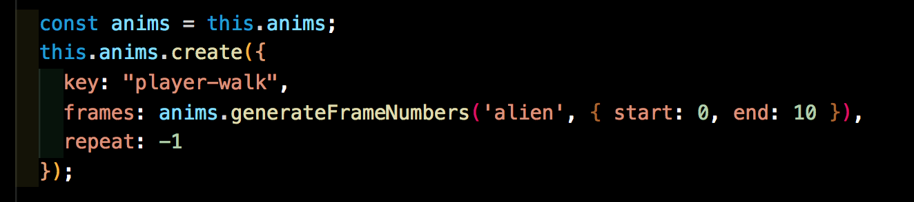
Creating Animations
Notes:
This is how we’ll define our animations (in the create() function)
Key – what we’ll use to call our animation later
Frames – the frames we want to display and order
Repeat – should the animation play once, 3 times or infinitely when called?
And this is how you play an animation.
this.player refers to our alien character and we’ll specify the key to play

Slide 15
Input and Physics

Slide 16
Physics
Don’t need to know a ton of Physics to build fun games
Gravity – like Sir Isaac Newton and the apple
Body – outer shell of the GameObject that represents boundaries
Collider – detects when bodies come into contact
Overlap – detects when bodies are overlapping
Notes:
Thanks to other developers, you don’t really need to know a lot of Physics to build games anymore. Just basic concepts:
- Gravity --- no complicated formulas or forces you need to understand. Just a number (positive moves up on X and right on Y, negative moves down on X and left on Y)
- Body --- a shell that defines the physical space your object takes up
- Collider --- detects when a body of one object runs into a body of another object
- Overlap --- detects when a body of one object is on top of a body of another object
Phaser has a couple of options when it comes to Physics. The built-in library that we’ll be using is called Arcade Physics. Some other options are Matter.js and Impact.js for more complicated behaviors.

Slide 17
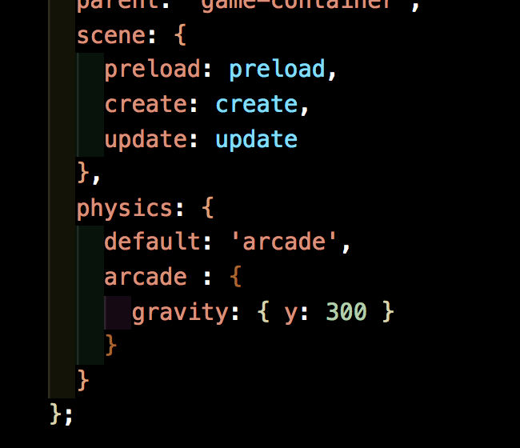
Adding Physics to our Game
Using Phaser’s default: Arcade Physics
Specifying gravity with a y = 300
Notes:
We’re going to add this to our game config object, specifying we want to use Arcade (the built-in Physics library) as our default and we’ll go ahead and add this arcade setup and set our gravity to a y : 300. This means that we our game to have a normal direction of gravitational pull and a pretty moderate level of force.
Pop back to the game, and you’ll see that nothing looks any different… We need to update our player to show that it should be affected by the game’s physics. We do this by making the player a child of our physics property like this: this.player = this.physics.add.sprite(etc.)
Now pop back over to the game and watch our player fall. Just for fun, try a few different values here and get a feel for the range of gravity you can apply. Try a negative!

Slide 18
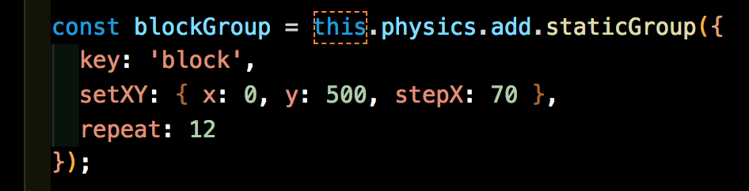
Bodies and Debugging
If we set debug to true on our physics property, we can see the body that’s drawn around an object
Notes:
Set debug to true, set this.player.body.debugBodyColor = 0x00ffff; and show the blue box drawn around the player
As I mentioned, bodies are good for determining collision and overlap. So lets throw a collision on there between our player and the ground.
First, we need to create a group for our blocks. Groups allow us to create multiple objects with the same configurations.
Once group is created, add collider between player and block group
Adjust size of player body with player.body.setSize(x, y) to show body determines collision point. This will be a lot of help later when we want to add in our keys and enemies.

Slide 19
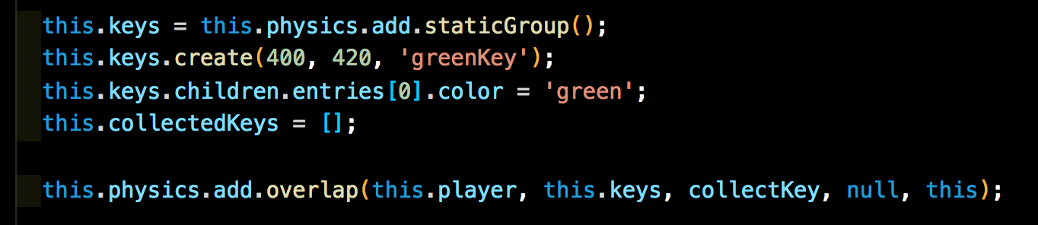
Keys and Locks
Use overlap to set up collection and unlock behaviors
Collection = when player overlaps key, add key to player’s inventory
Notes:
So lets add our first key. Go ahead and put this code in your create function and I’ll talk you through it.

Slide 20
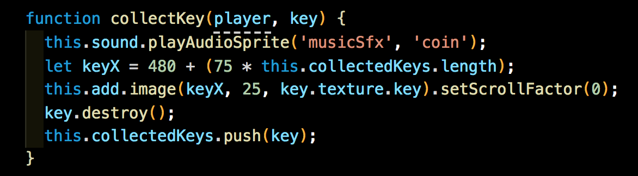
Keys and Locks
Notes:
So lets add our first key. Go ahead and put this code in your create function and I’ll talk you through it.

Slide 21
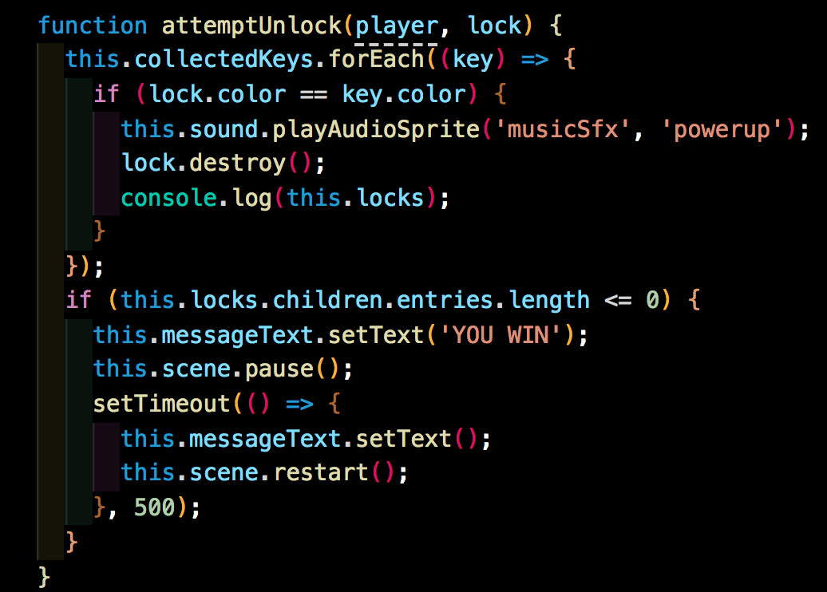
Keys and Locks
Notes:
So lets add our first key. Go ahead and put this code in your create function and I’ll talk you through it.

Slide 22
Controls and Cameras

Slide 23

Cameras
Cameras define viewable areas and allow for special effects
Can be positioned, rotated, zoomed and scrolled
Saves time creating custom methods to do simple things
This Photo by Unknown Author is licensed under CC BY-SA
Notes:
A game area can be MASSIVE (think scrolling maps, multiple levels, etc).
Cameras:
- help scale down what’s viewable at a given time.
- provide a view into your game world that can be positioned, rotated, zoomed and scrolled
Phaser Cameras also have built-in methods for doing common things like:
- Following a character
- Defining world boundaries
- Providing feedback events like a shake on collision, blur on scene change, etc.
Just some of the MANY, MANY things the Phaser Library brings to the table. Now let’s take a look at what we’re going to build.

Slide 24
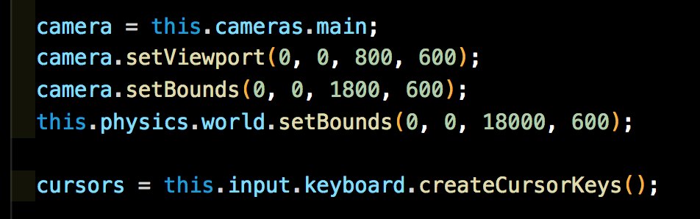
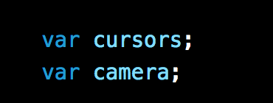
Setup for Cursors and Cameras
Create function
After config
Notes:
Set debug to true, set this.player.body.debugBodyColor = 0x00ffff; and show the blue box drawn around the player
As I mentioned, bodies are good for determining collision and overlap. So lets throw a collision on there between our player and the ground.
First, we need to create a group for our blocks. Groups allow us to create multiple objects with the same configurations.
Once group is created, add collider between player and block group
Adjust size of player body with player.body.setSize(x, y) to show body determines collision point. This will be a lot of help later when we want to add in our keys and enemies.

Slide 25
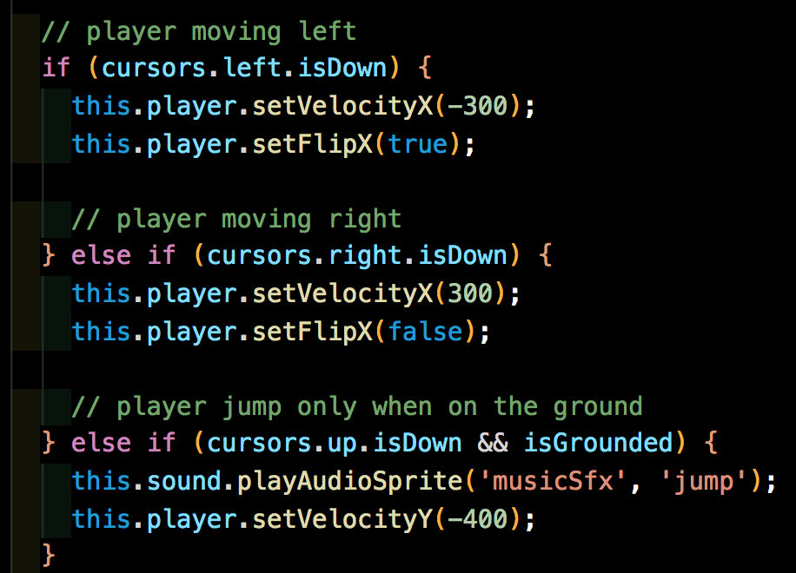
Setup for Cursors and Cameras
Update function
Notes:
Set debug to true, set this.player.body.debugBodyColor = 0x00ffff; and show the blue box drawn around the player
As I mentioned, bodies are good for determining collision and overlap. So lets throw a collision on there between our player and the ground.
First, we need to create a group for our blocks. Groups allow us to create multiple objects with the same configurations.
Once group is created, add collider between player and block group
Adjust size of player body with player.body.setSize(x, y) to show body determines collision point. This will be a lot of help later when we want to add in our keys and enemies.

Slide 26
Thank You

